Slide 1
Subject – English Grammar
Topic – Pronoun
Class – III
Made by- Smriti Maheshwari

Slide 3
Definition – A Pronoun is a word that takes the place of a noun.

Slide 4
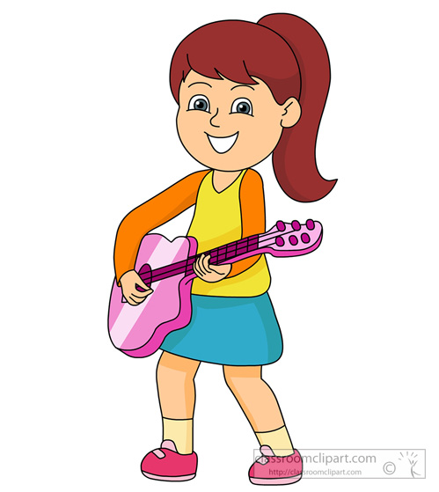
For Example:-
Tina plays guitar.
Proper noun
She plays guitar.
Pronoun

Slide 5
Ben is fishing.
Proper noun
He is fishing.
Pronoun

Slide 6
Nicole reads a book. Nicole Enjoys the book.
Proper noun Common noun
Nicole reads a book. He enjoys it.
Pronoun

Slide 7
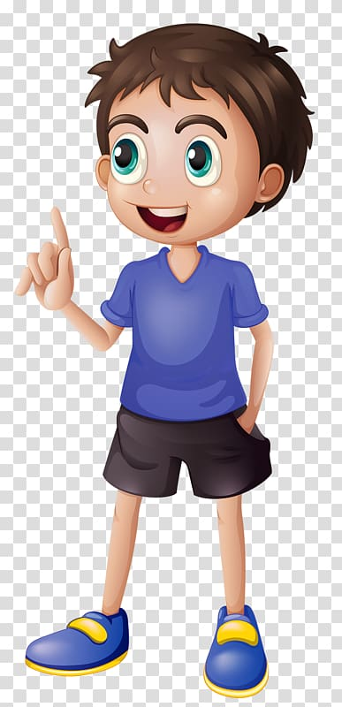
Jack look cool in blue.
Proper noun
You look cool in blue.
Pronoun

Slide 8
Sam is happy.
Proper noun
I am happy.
Pronoun

Slide 9
Rachel and Amy are friends.
Proper noun
They are friends.
Pronoun

Slide 10
Pronoun replaces a noun or nouns in the naming part (noun) of a sentence.

Slide 11
I | IT | HIM
YOU | WE | HER
HE | THEY | HIS
SHE | ME | THEM

Slide 12
