Slide 1
Chapter -1 Democracy Topic-1

Slide 2
What is the Government?
The government is the body that governs or administers a political unit like a country or state.

Slide 3
Functions of the Government
To make laws.
To settle disputes.
To maintain security and enforce public order and discipline.
To provide and maintain public facilities like roads, supply of water and electricity and public transports.

Slide 4
Different types of Government
Monarchy
Oligarchy
Theocracy
Dictatorship
Democracy

Slide 5
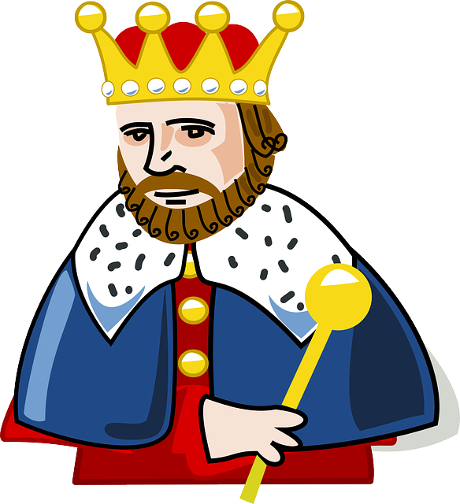
Monarchy
A form of government with a single ruler (king/queen or emperor) at the head.
For example: Saudi Arabia

Slide 6
Oligarchy
A small group of people having control of a country or organization.
For example, ancient Rome

Slide 7
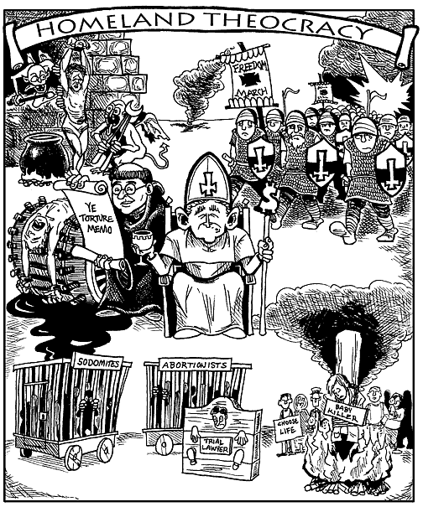
Theocracy
A system of government in which religious leaders rule in the name of God.
For example, Iran

Slide 8
Dictatorship
It is a form of government where a person or group of people , who have seized power by force rule.
For example, Germany under Hitler

Slide 9
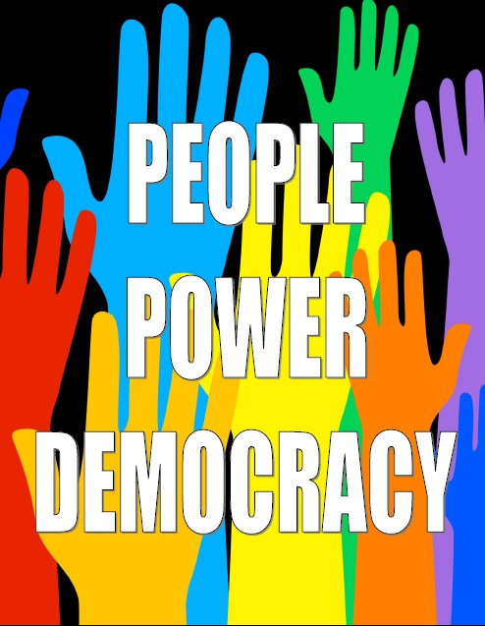
Democracy
It is a form of government in which the people govern the country directly or indirectly through their elected representatives.
For example, India

Slide 10
Worksheet
Mention any two functions of the government.
Distinguish between Monarchy and Democracy.
Define government.
Give one example of Oligarchy form of government.
Who are the rulers in Theocratic form of government.
Write a short note on Dictatorship form of government.

